Slide 1
KC Donation
Roshna Toke

Slide 2
Objective
The main objective of this project is to design a system where donors (those who have excess items) can donate their items only by posting its description on the system and then the requester will request that as per their need and collect from a given address.

Slide 3
features
Those who have access items and want to donate, they can post the same in application.
When donor post the item, all the requester will get an email notification.
Requester simply request any item and collect it from given address and can also view specific type of items.
Both donor and requester can their history of donation and requested item respectively.
Both donor and requester can update their profile information.
If user forget his/her password, we will send random password his/her registered email id.

Slide 4
Technologies used
Angular
HTML, CSS & Bootstrap
Node.js
Mongo DB
Links
https://kcdonation.herokuapp.com
https://github.com/roshna1924/KC-Donation

Slide 5
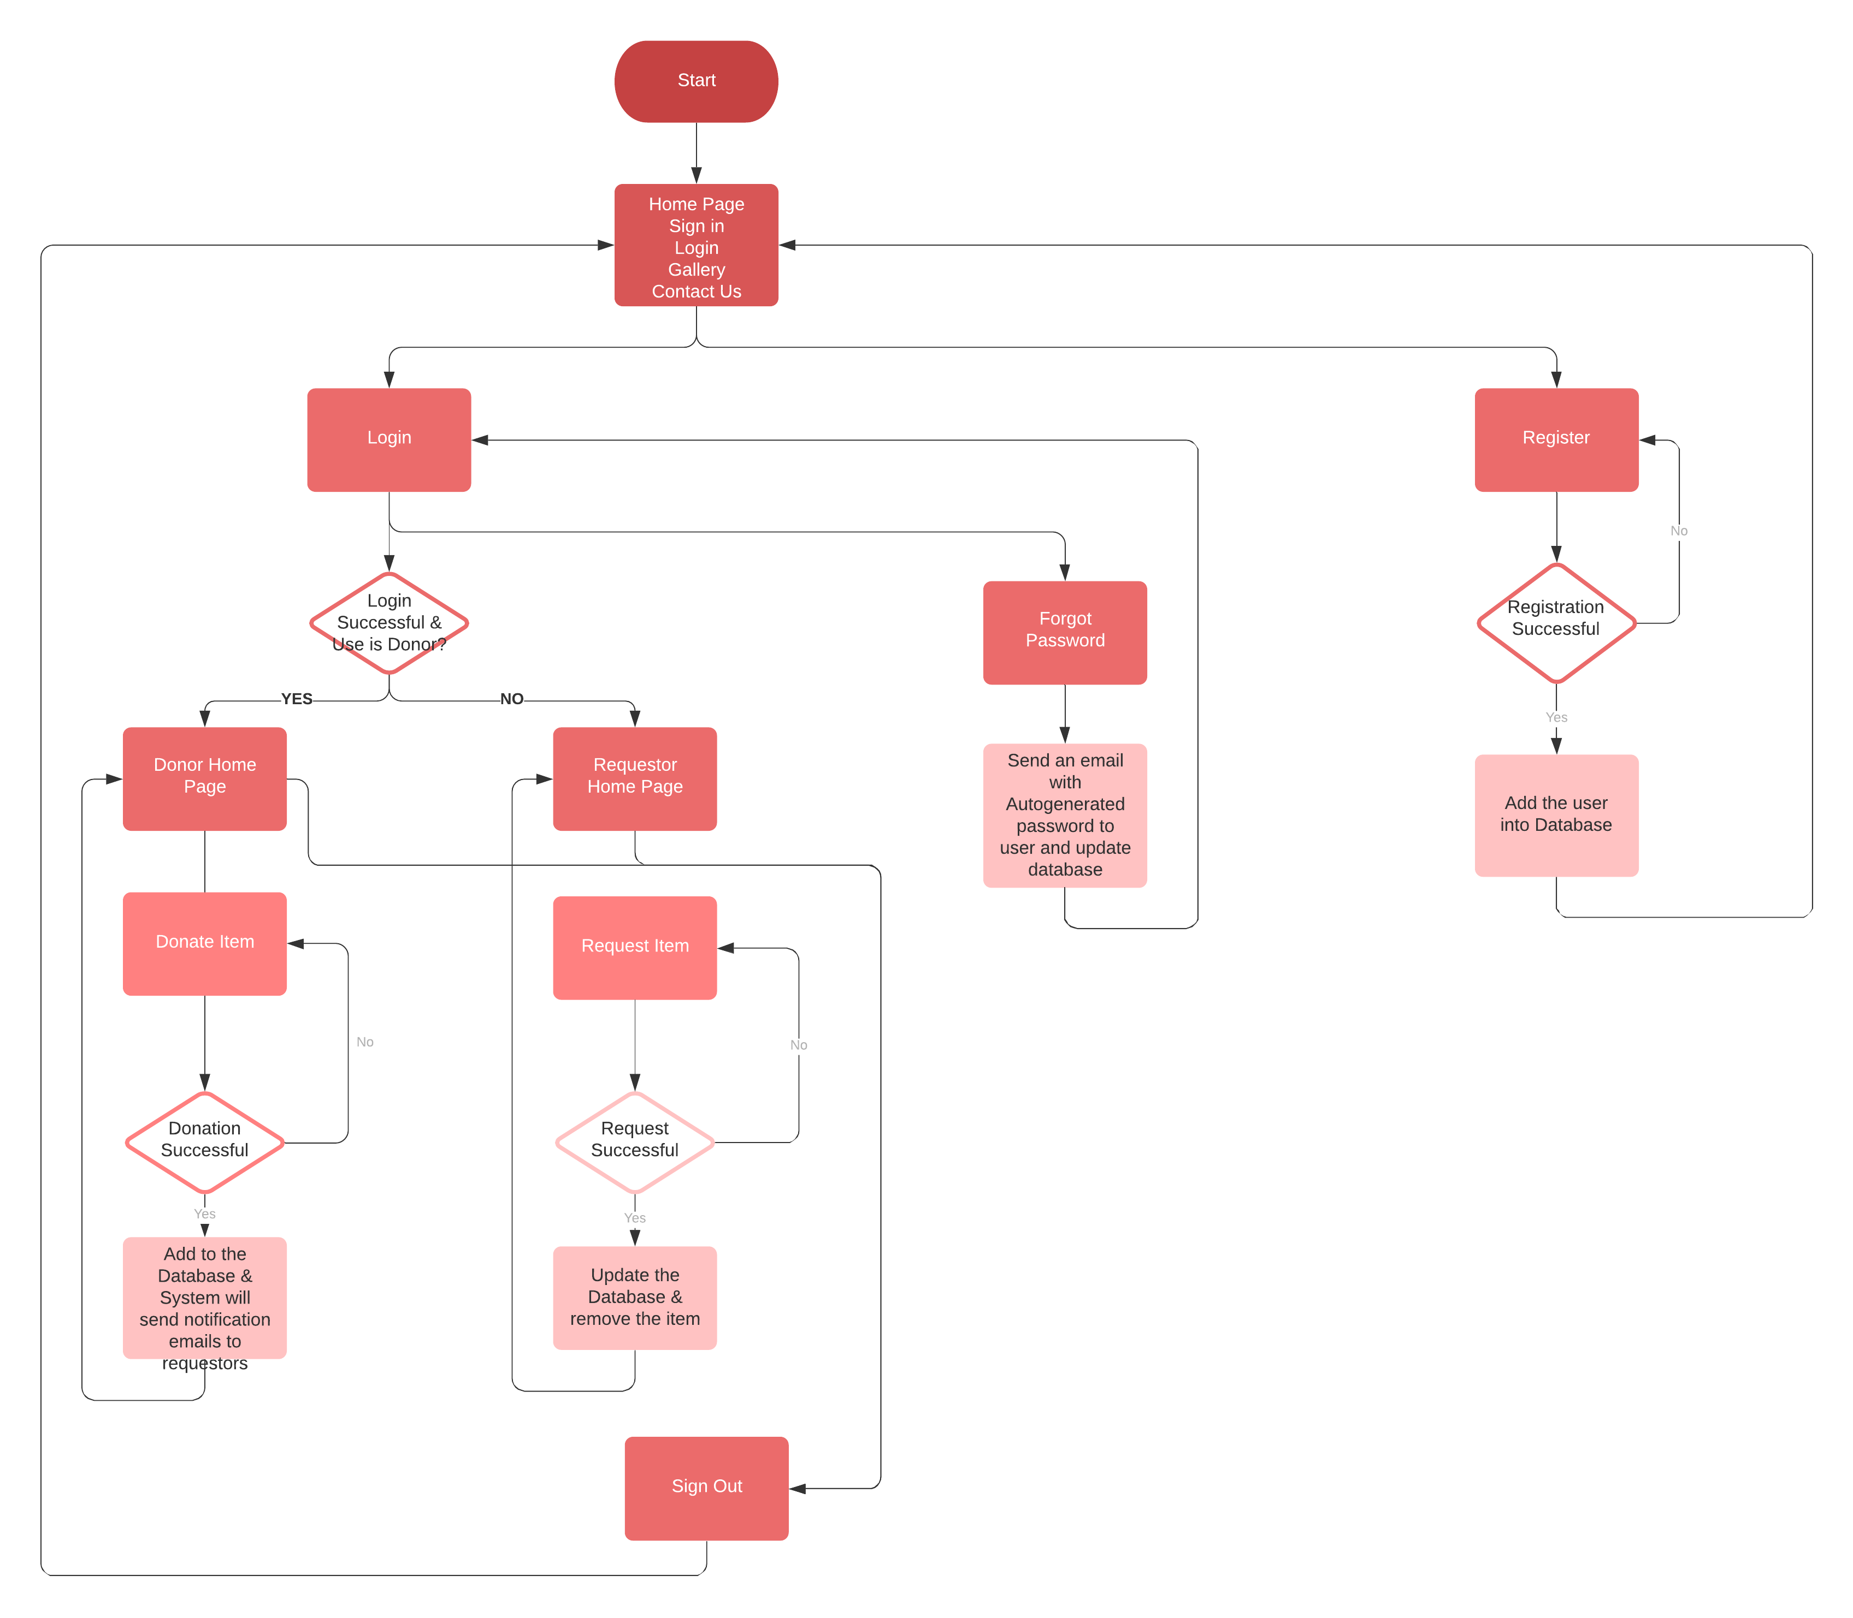
Workflow Diagram

Slide 6
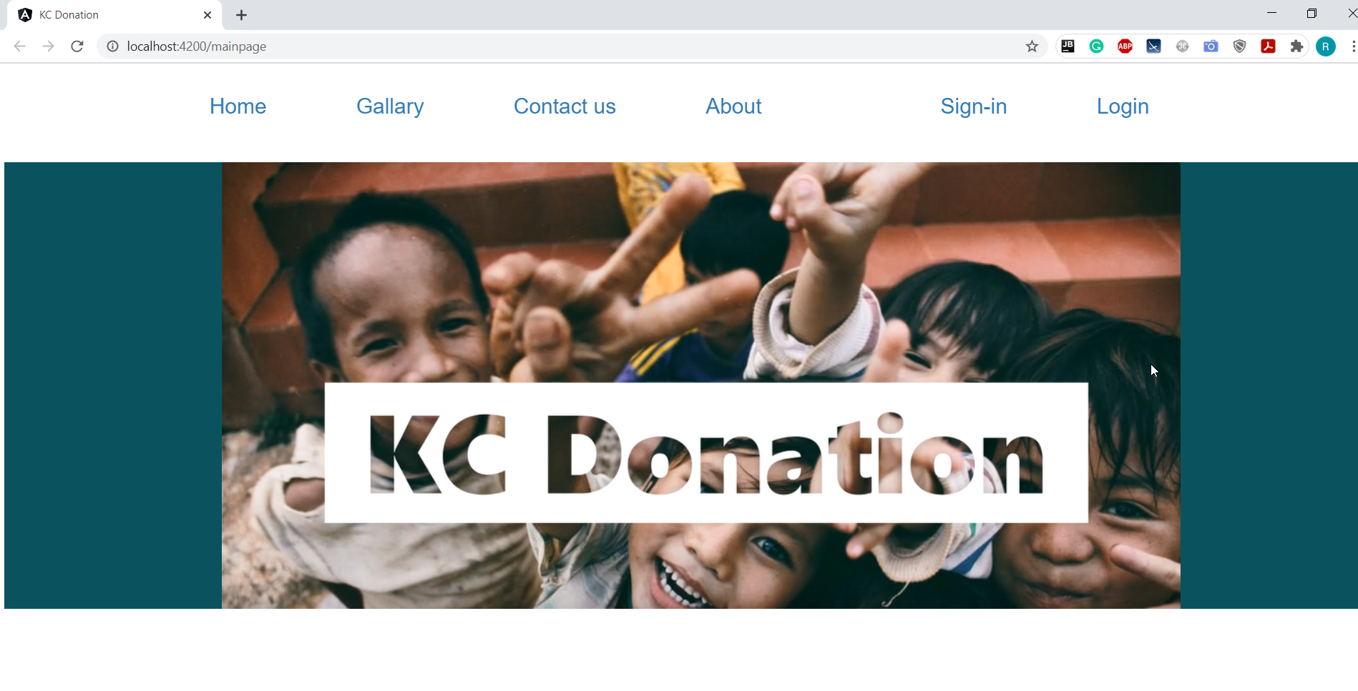

Slide 7
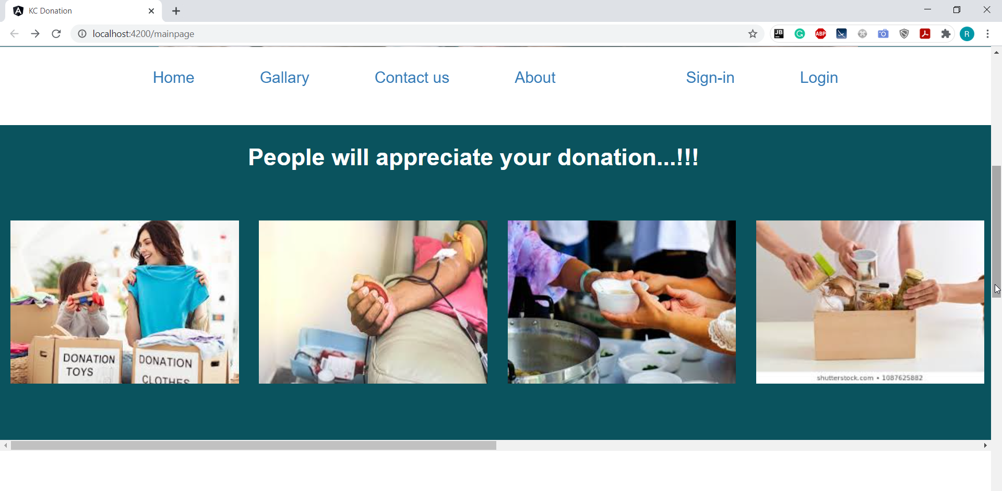

Slide 8
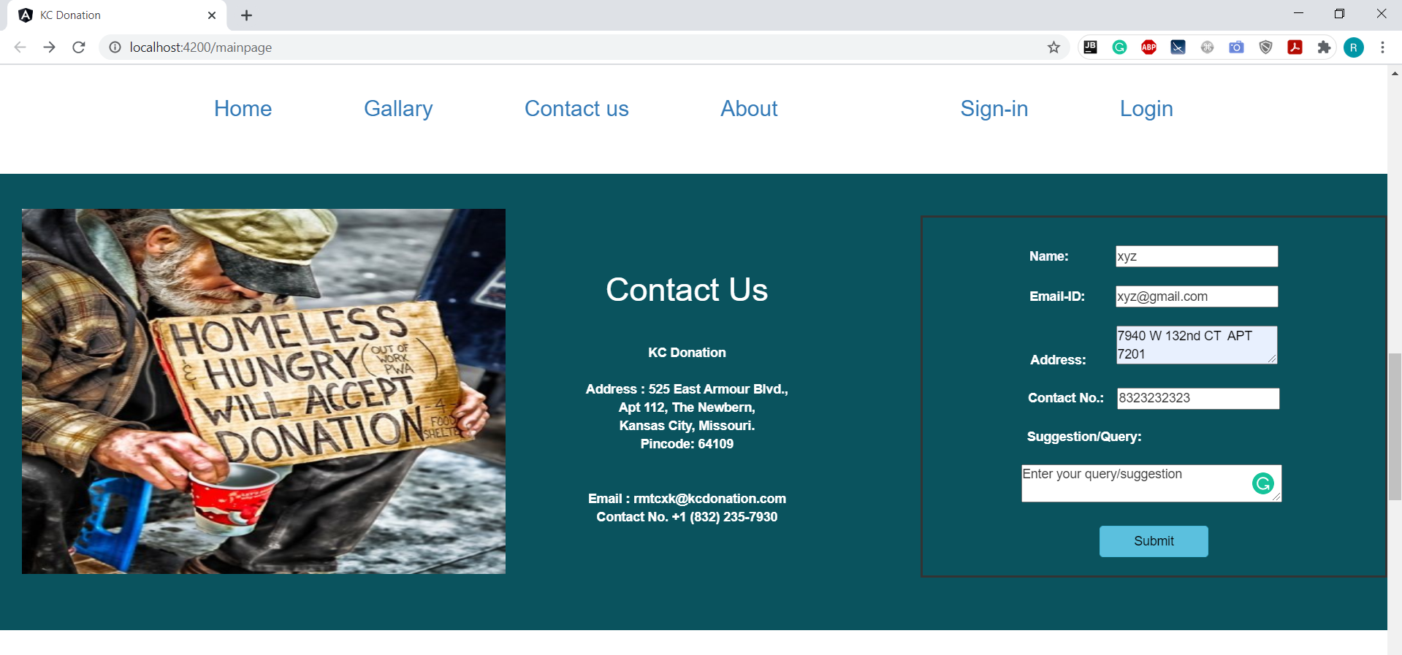

Slide 9
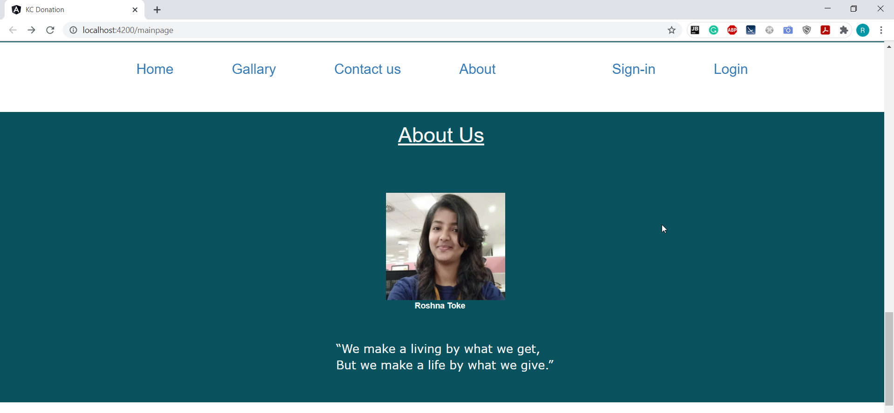

Slide 10
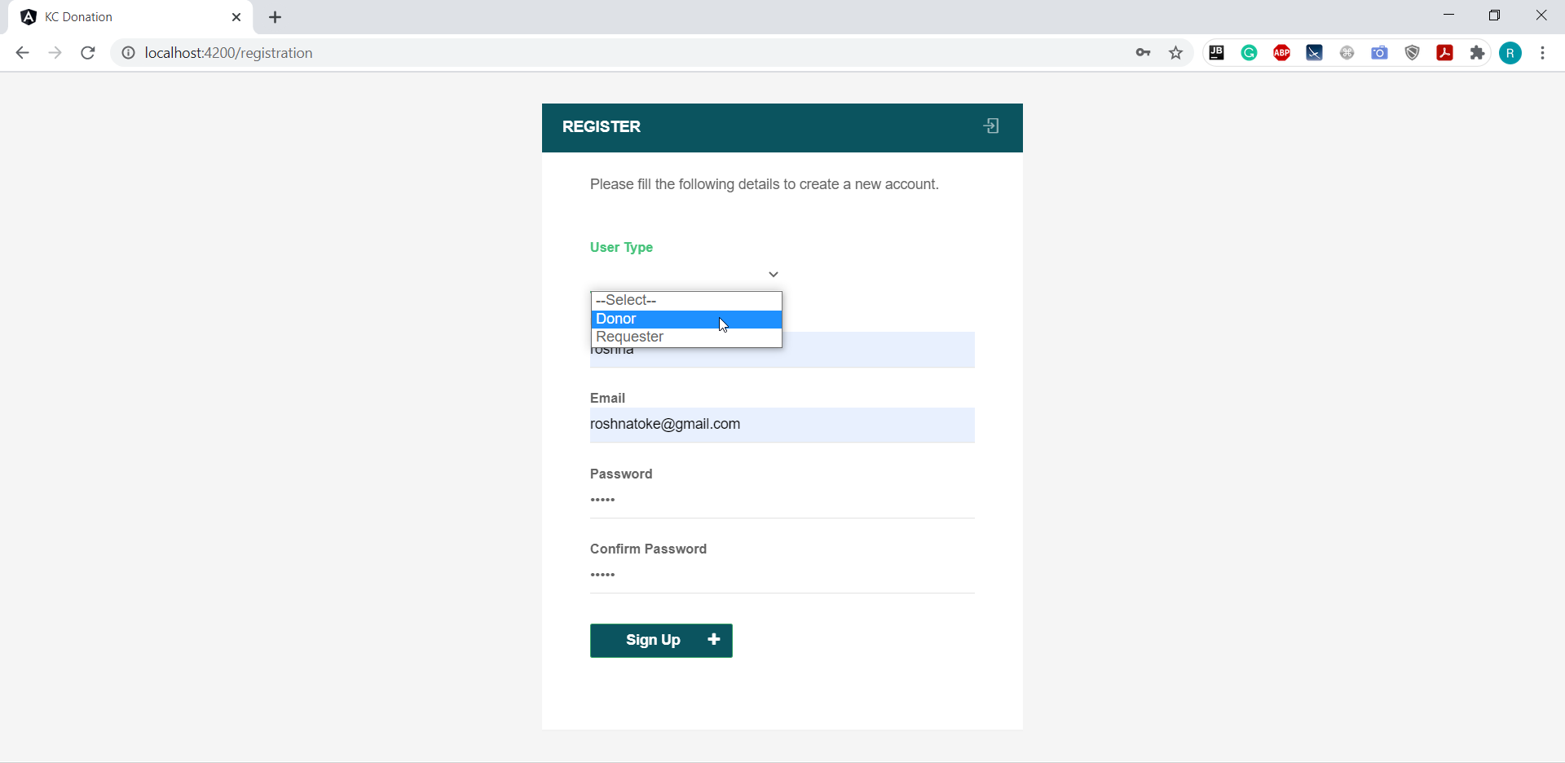

Slide 11
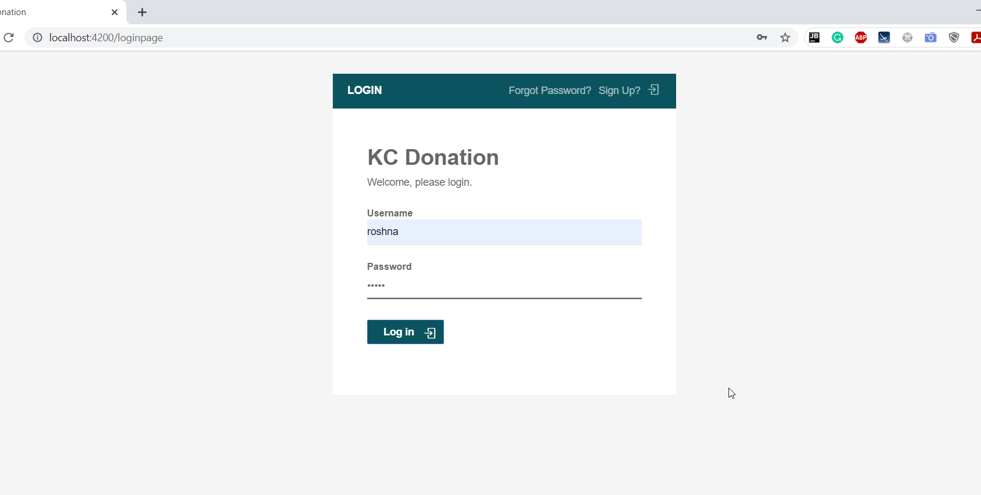

Slide 12
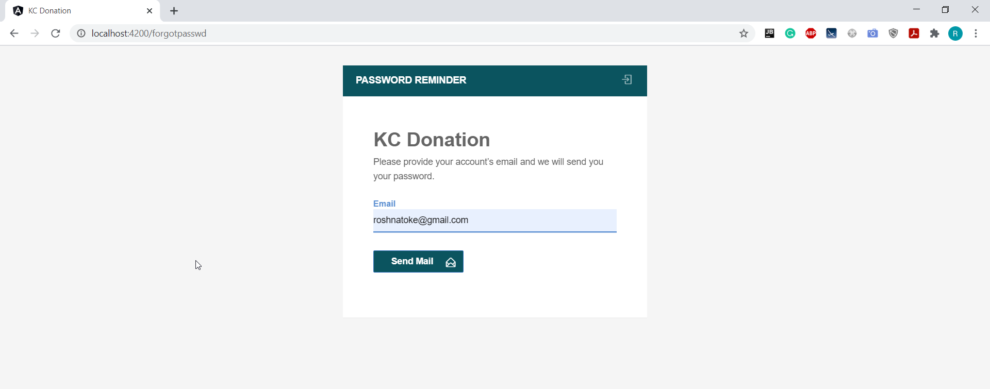

Slide 13
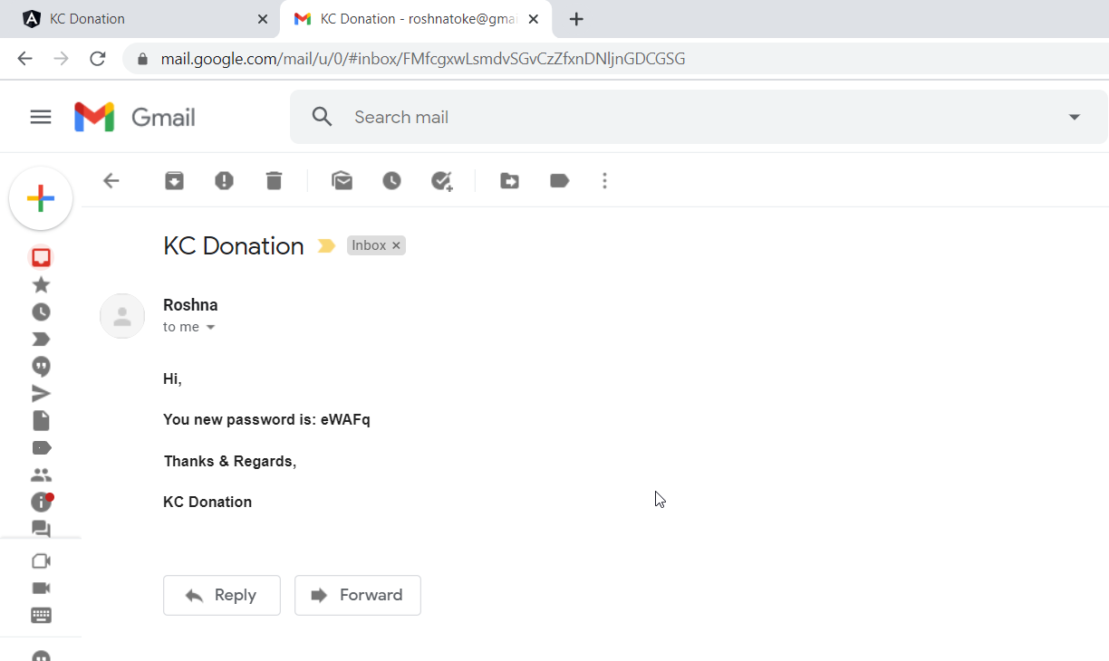

Slide 14
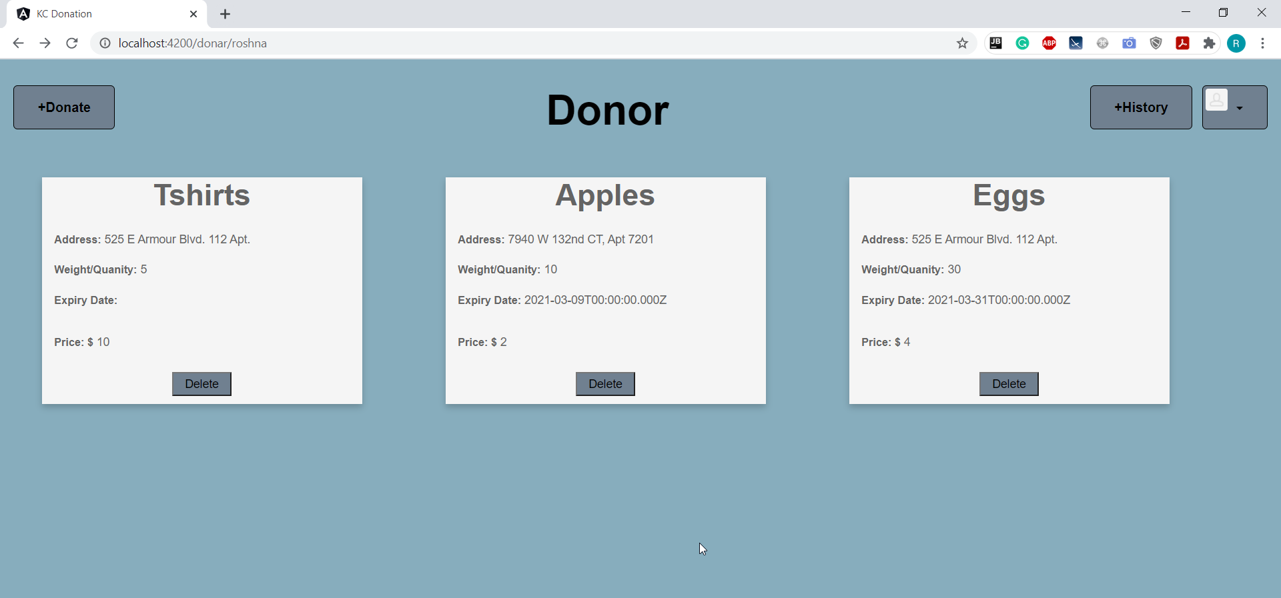

Slide 15
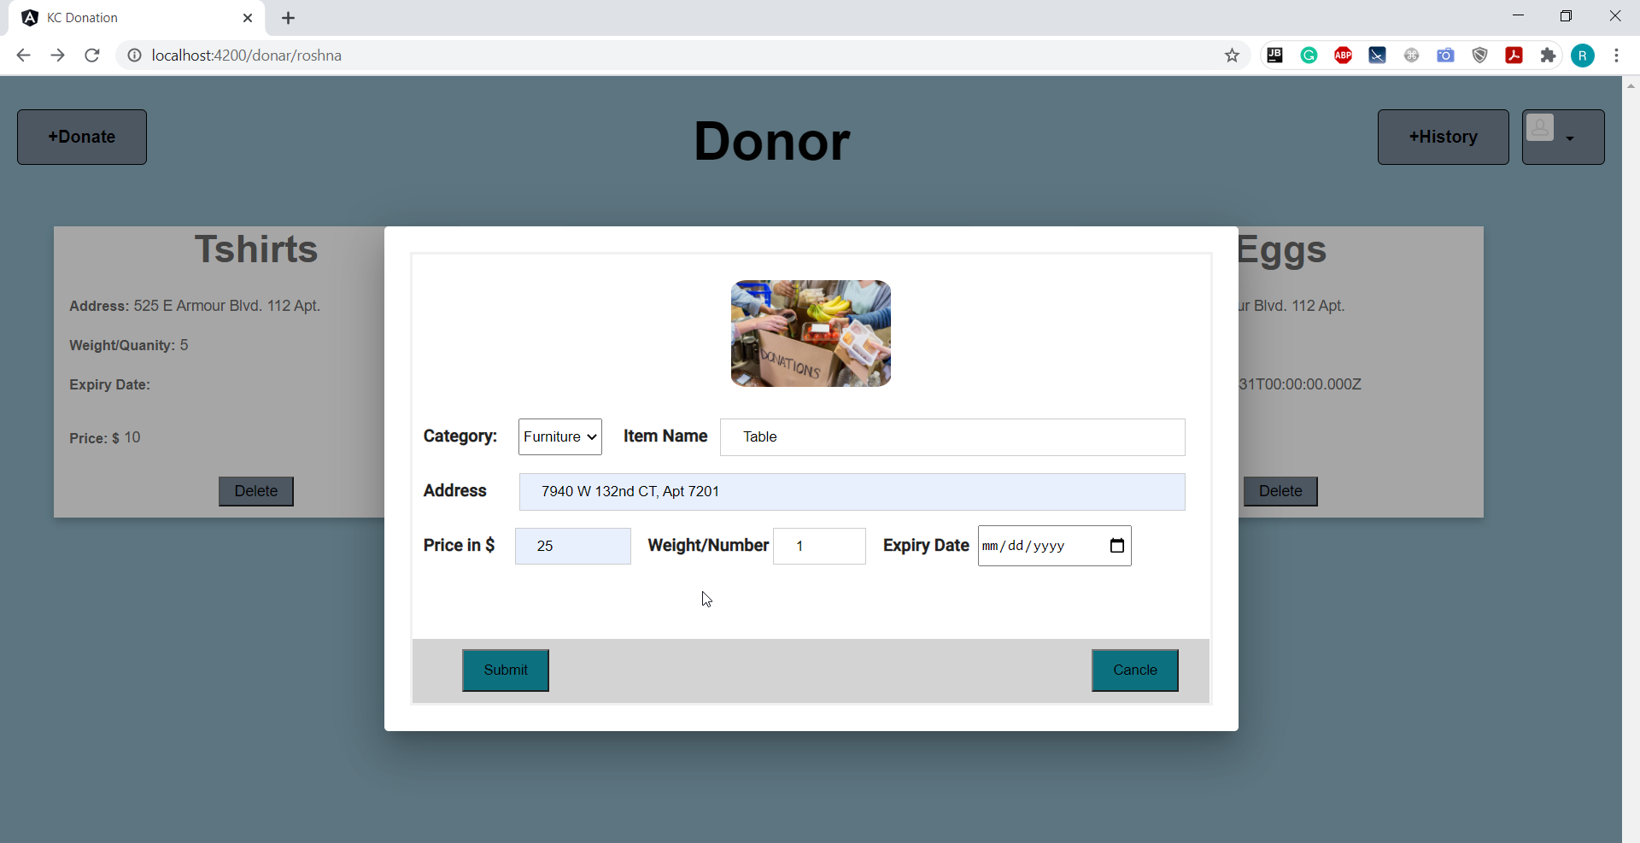

Slide 16
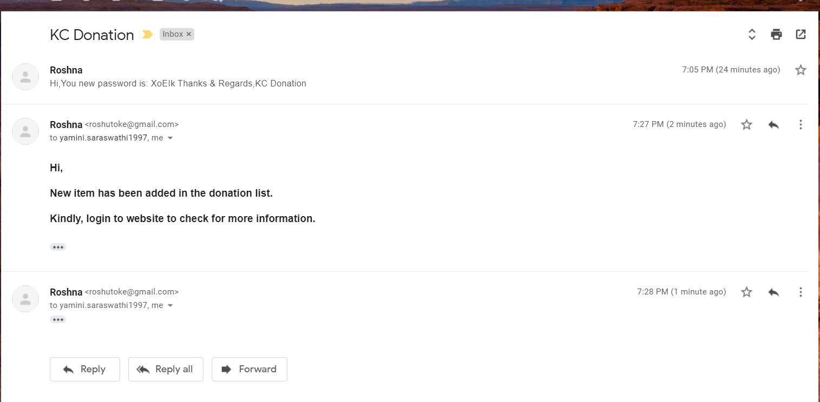

Slide 17
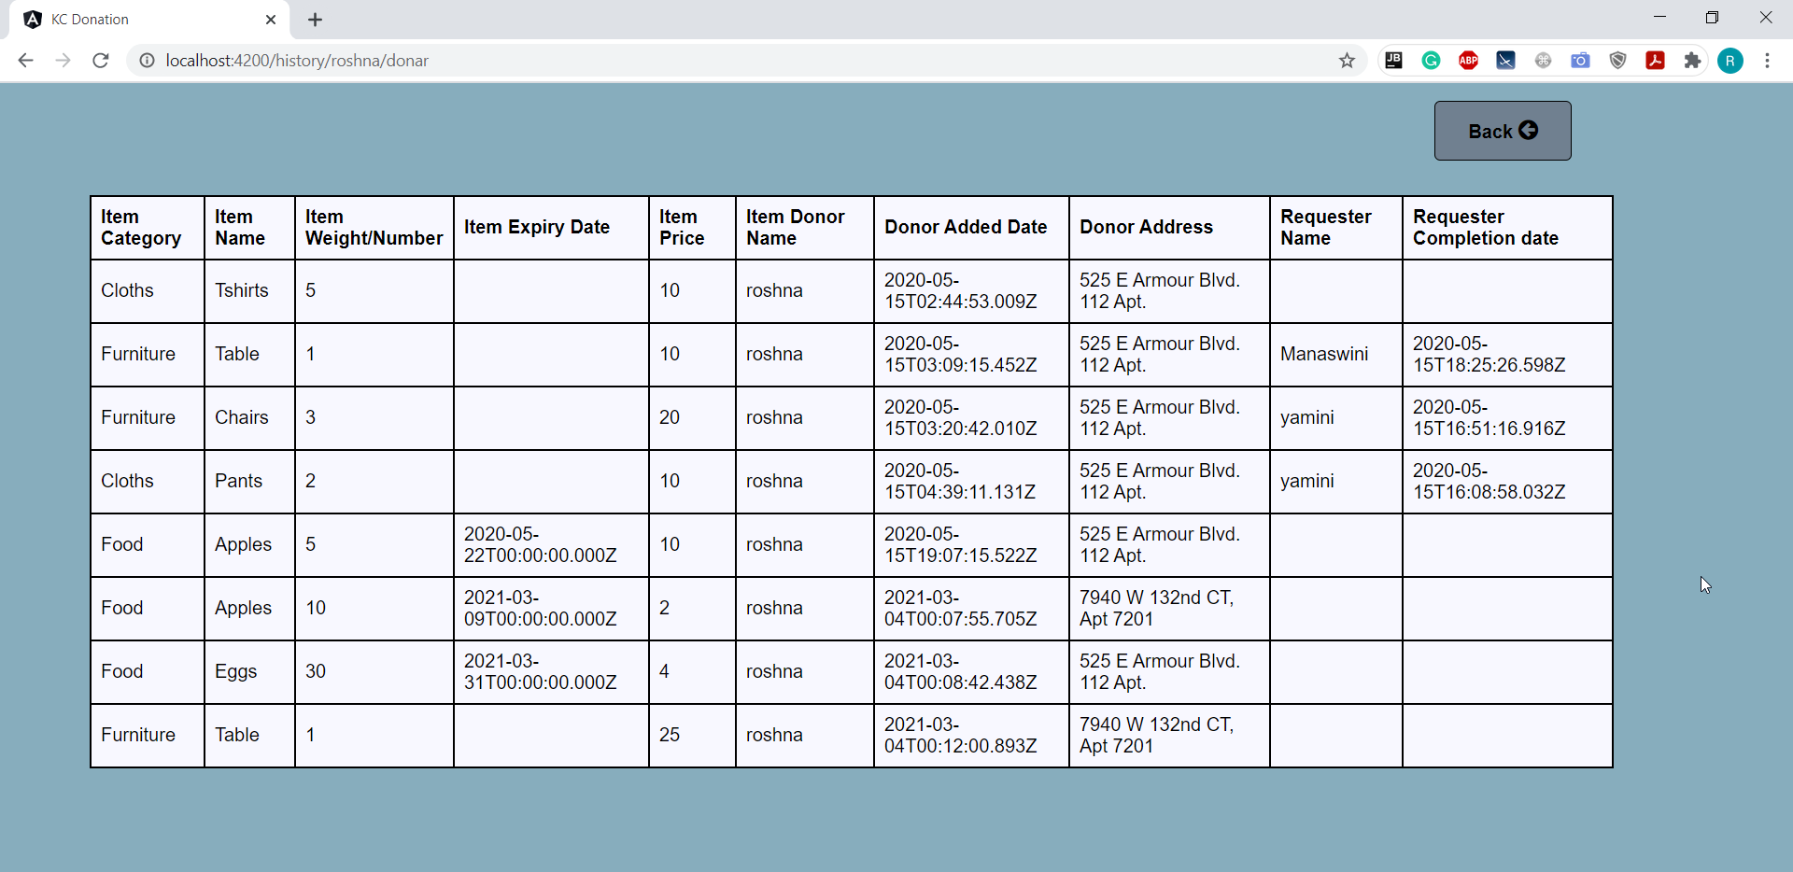

Slide 18
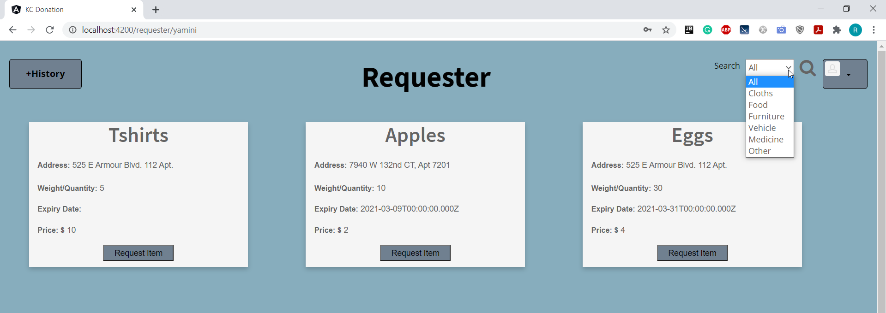

Slide 19
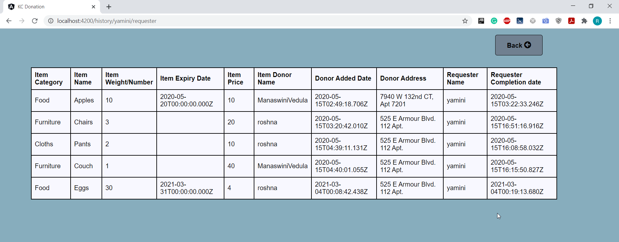

Slide 20
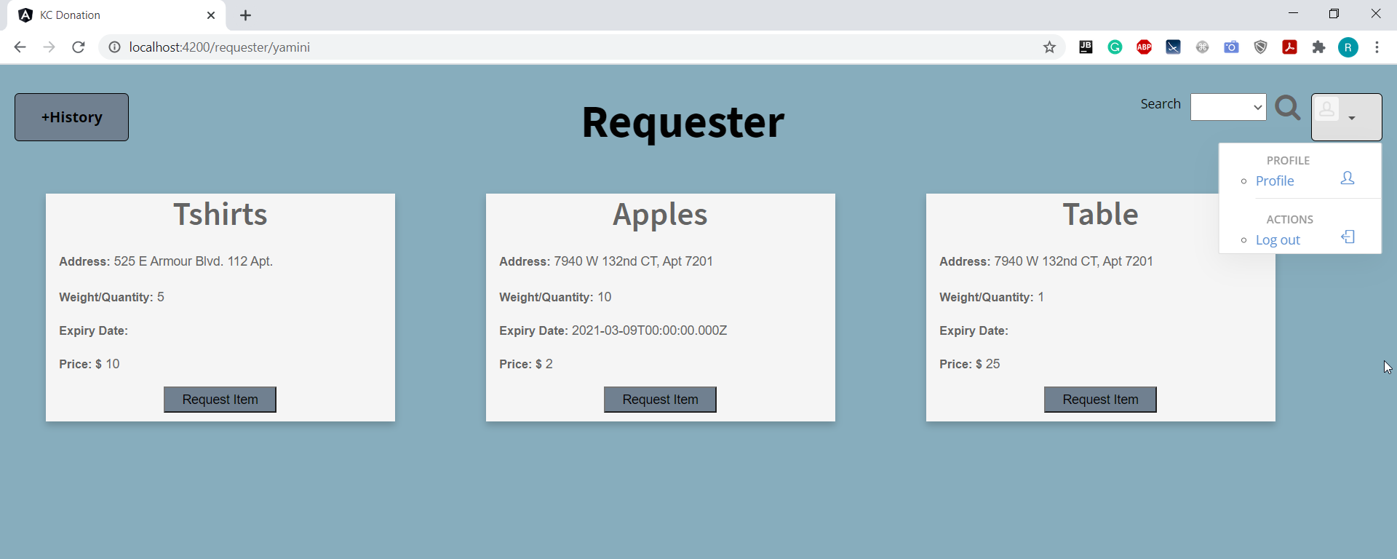

Slide 21
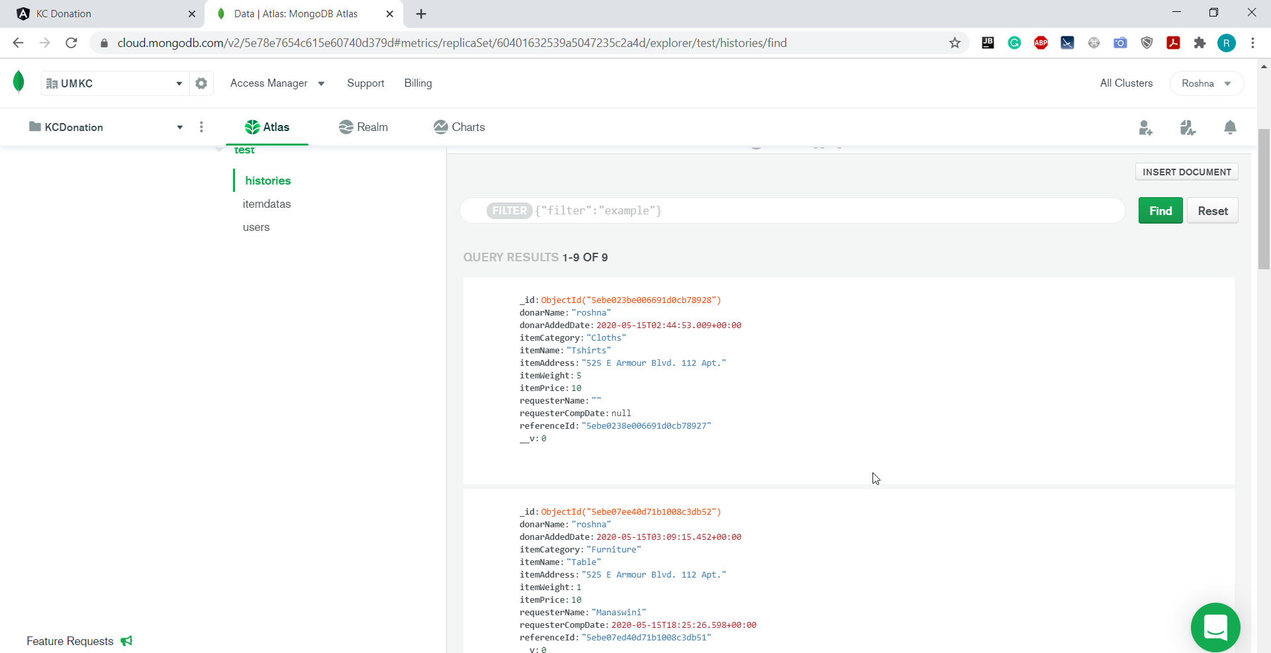

Slide 22
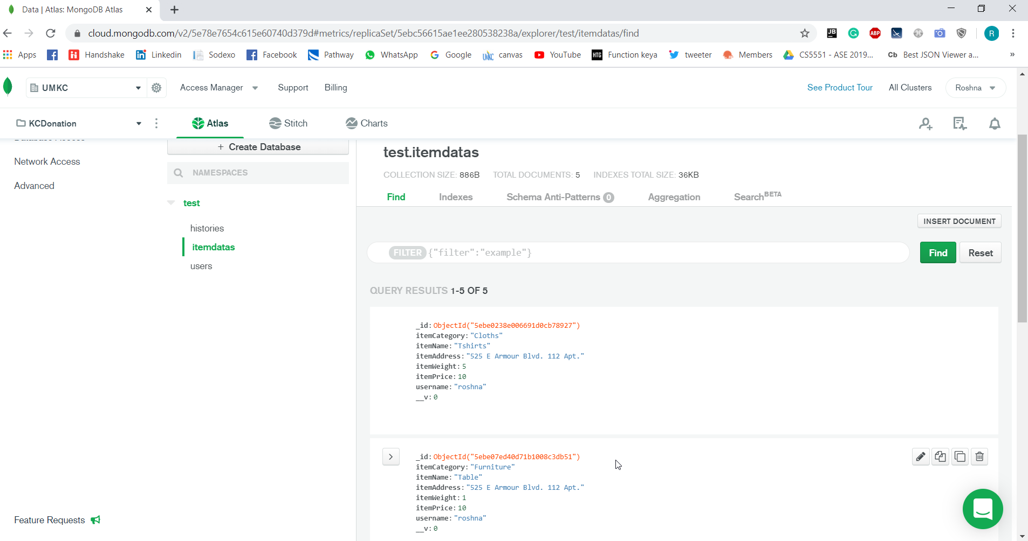

Slide 23
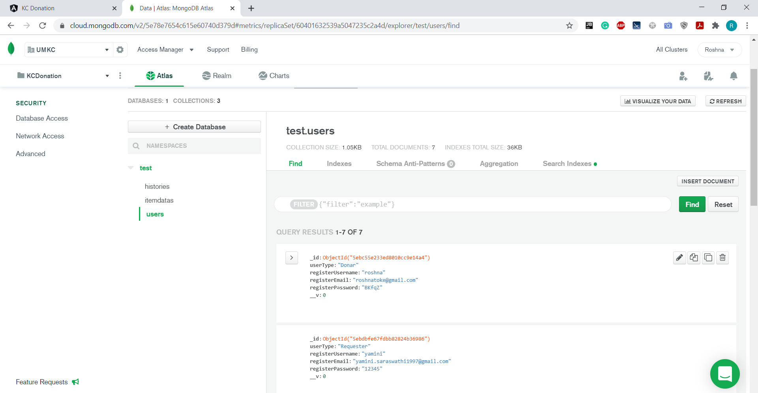

Slide 24
Learning
Learnt about new technologies like Angular, Node.js, Mongo DB
Usage of Node mailer.
MVC architecture

Slide 25
references
https://angular.io/tutorial
https://docs.mongodb.com/manual/tutorial/
https://mongoosejs.com/docs/api.html
https://nodemailer.com/usage/using-gmail/
https://www.techiediaries.com/angular-9-8-mean-stack-authentication-tutorial-and-example-with-node-and-mongodb/
https://www.youtube.com/watch?v=UYh6EvpQquw

Slide 26

Thank you
Any questions?

